Slide 1
Fair use notice
The material used in this presentation i.e., pictures/graphs/text, etc. is solely intended for educational/teaching purpose, offered free of cost to the students for use under special circumstances of Online Education due to COVID-19 Lockdown situation and may include copyrighted material - the use of which may not have been specifically authorized by Copyright Owners. It’s application constitutes Fair Use of any such copyrighted material as provided in globally accepted law of many countries. The contents of presentations are intended only for the attendees of the class being conducted by the presenter.

Slide 2
OBJECT ORIENTED PROGRAMMING
Presented by: Engr. Mariam Memon

Slide 3

Table of contents
Exceptions
Exception Handling
Custom Exceptions

Slide 4
Exception
Dictionary Meaning: Exception is an abnormal condition.
An Exception is an unwanted event that interrupts the normal flow of the program.
When an exception occurs program execution gets terminated. In such cases we get a system generated error message.
The good thing about exceptions is that they can be handled in Java.
By handling the exceptions we can provide a meaningful message to the user about the issue rather than a system generated message, which may not be understandable to a user.

Slide 5
Why Exceptions Occur?
There can be several reasons that can cause a program to throw exception.
For example:
Opening a non-existing file in your program
Network connection problem
bad input data provided by user etc.

Slide 6
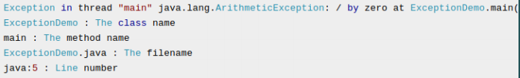
Uncaught Exception
If an exception occurs, which has not been handled by programmer then program execution gets terminated and a system generated error message is shown to the user.
For example look at the system generated exception below:

Slide 7
Exception Handling
This message is not user friendly so a user will not be able to understand what went wrong.
In order to let them know the reason in simple language, we handle exceptions.
We handle such conditions and then prints a user-friendly warning message to user, which lets them correct the error as most of the time exception occurs due to bad data provided by user.

Slide 8
Throwing an Exception
Whenever such error occurs while executing a statement
JAVA creates an exception object
the normal flow of the program halts
JRE tries to find someone that can handle the raised exception.
The exception object contains a lot of debugging information such as
method hierarchy (call stack)
line number where the exception occurred
type of exception etc.
When the exception occurs in a method, the process of creating the exception object and handing it over to runtime environment is called “throwing the exception”.

Slide 9
Exception Handling – Catching the Exception
Once runtime receives the exception object, it tries to find the handler for the exception.
Exception Handler is the block of code that can process the exception object.
The logic to find the exception handler is simple – starting the search in the method where error occurred, if no appropriate handler found, then move to the caller method and so on.
So if methods call stack is A->B->C and exception is raised in method C, then the search for appropriate handler will move from C->B->A.
If appropriate exception handler is found, exception object is passed to the handler to process it.
The handler is said to be “catching the exception”.
If there are no appropriate exception handler found then program terminates printing information about the exception.

Slide 10
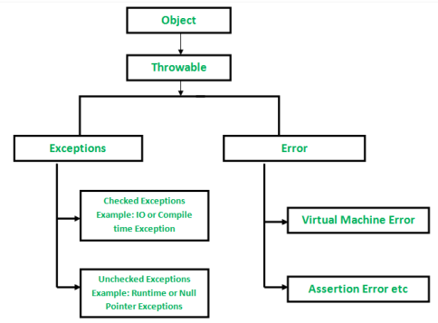
Class Hierarchy of Exceptions

Slide 11
Errors vs Exceptions
Errors are exceptional scenarios that are out of scope of application and it’s not possible to anticipate and recover from them, for example hardware failure, JVM crash or out of memory error.
Exceptions are events that occurs in the code. A programmer can handle such conditions and take necessary corrective actions. Few examples:
NullPointerException – When you try to use a reference that points to null.
ArithmeticException – When bad data is provided by user, for example, when you try to divide a number by zero this exception occurs because dividing a number by zero is undefined.
ArrayIndexOutOfBoundsException – When you try to access the elements of an array out of its bounds

Slide 12
Types of Exception
Checked Exceptions
Exceptions that the compiler check during compilation to see whether the programmer has handled them or not.
If these exceptions are not handled/declared in the program, you will get compilation error.
For example, SQLException, IOException, ClassNotFoundExceptionetc.
Unchecked Exception
Also known as Run-Time Exceptions
These exceptions are not checked at compile-time so compiler does not check whether the programmer has handled them or not but it’s the responsibility of the programmer to handle these exceptions and provide a safe exit.
For example, ArithmeticException, NullPointerException, ArrayIndexOutOfBoundsException etc.

Slide 13
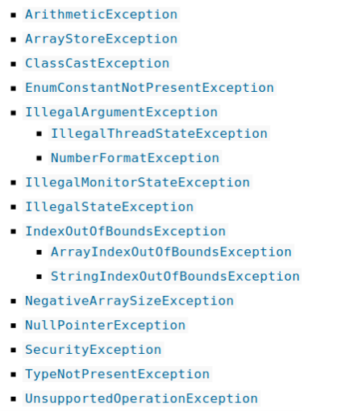
Some Runtime Exceptions

Slide 14
Exception Handling
try – catch block
Multiple catch blocks
Nested try – catch blocks
finally Block
throws
throw

Slide 15

Try-Catch Block
Try block
The try block contains set of statements where an exception can occur.
A try block is always followed by a catch block, which handles the exception that occurs in associated try block.
Syntax

Slide 16
Contd.
Catch block
A catch block is where you handle the exceptions, this block must follow the try block.
A single try block can have several catch blocks associated with it. You can catch different exceptions in different catch blocks.
When an exception occurs in try block, the corresponding catch block that handles that particular exception executes.
For example if an arithmetic exception occurs in try block then the statements enclosed in catch block for arithmetic exception executes.

Slide 17
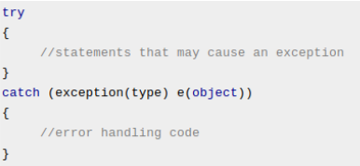
Try-Catch Block Syntax

Slide 18
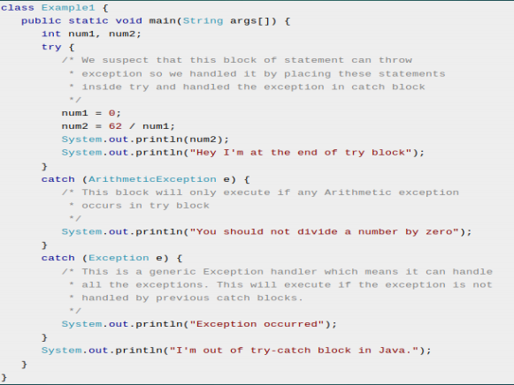
Example Code

Slide 19
Nested Try-Catch Block
When a try catch block is present in another try block then it is called the nested try catch block.
Each time a try block does not have a catch handler for a particular exception, then the catch blocks of parent try block are inspected for that exception, if match is found that that catch block executes.
If neither catch block nor parent catch block handles exception then the system generated message would be shown for the exception, similar to what we see when we don’t handle exception.

Slide 20
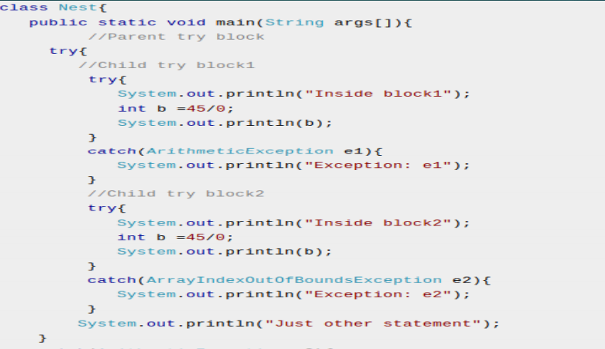

Slide 21
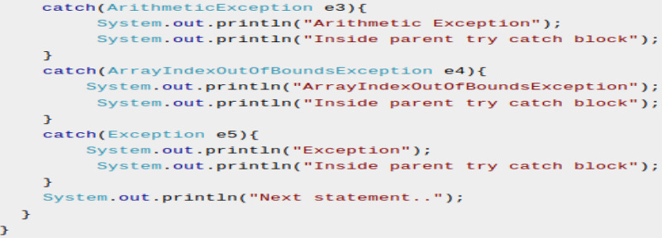
Contd.

Slide 22
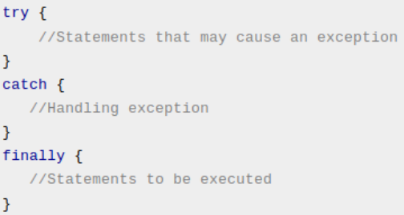
Finally Block
A finally block contains all the crucial statements that must be executed whether exception occurs or not.
Syntax:

Slide 23
Contd.
A finally block must be associated with a try block, you cannot use finally without a try block.
You should place those statements in this block that must be executed always.
Finally block is optional
In normal case when there is no exception in try block then the finally block is executed after try block.
However, if an exception occurs then the catch block is executed before finally block.

Slide 24
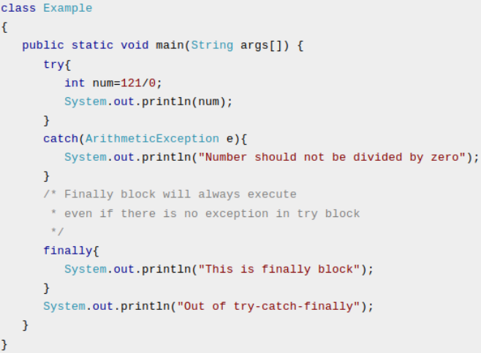
Example

Slide 25
Throw Keyword
The Java throw keyword is used to explicitly throw an exception.
We can throw either checked or uncheked exception in java by throw keyword.
The throw keyword is mainly used to throw custom exception. We will see custom exceptions later.
The syntax of java throw keyword is given below.
Syntax:
throw exception;

Slide 26
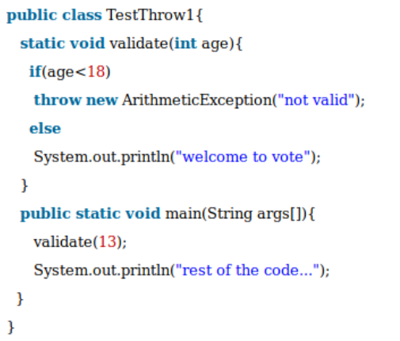
Example

Slide 27

throws
The Java throws keyword is used to declare an exception.
It gives an information to the programmer that there may occur an exception so it is better for the programmer to provide the exception handling code so that normal flow can be maintained.

Slide 28
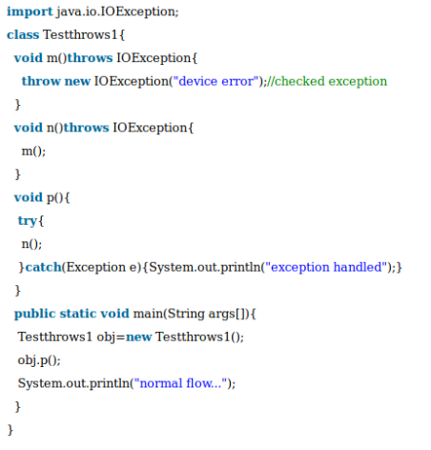
Example

Slide 29
Java Exception Propagation
An exception is first thrown from the top of the stack and if it is not caught, it drops down the call stack to the previous method
If not caught there, the exception again drops down to the previous method
and so on until they are caught or until they reach the very bottom of the call stack.
This is called exception propagation.

Slide 30
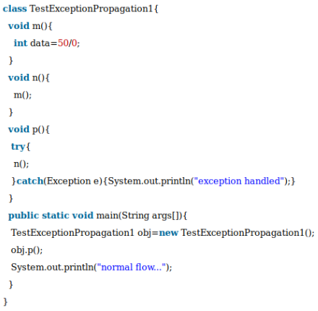
Example
In this example exception occurs in m() method where it is not handled,so it is propagated to previous n() method where it is not handled, again it is propagated to p() method where exception is handled.
Exception can be handled in any method in call stack either in main() method,p() method,n() method or m() method.

Slide 31
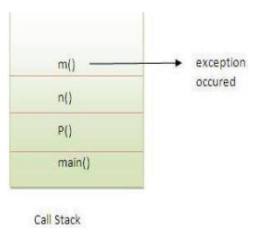
CALL stack

Slide 32
Java Custom Exceptions
If you are creating your own Exception that is known as custom exception or user-defined exception.
Java custom exceptions are used to customize the exception according to user need.
By the help of custom exception, you can have your own exception and message.

Slide 33
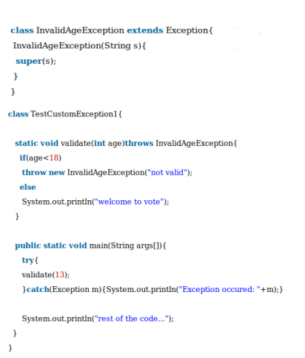

Example Code

Slide 34
THANK YOU!

